Slide 1

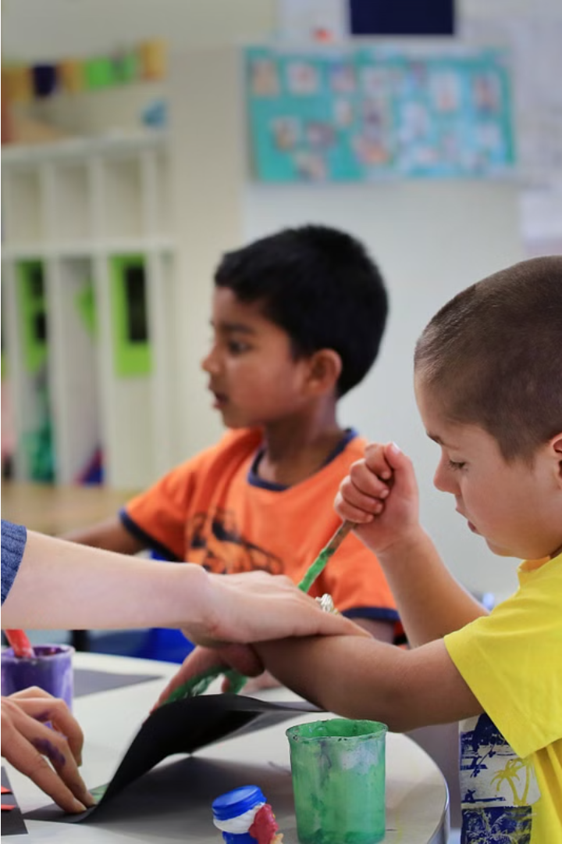

LifeSkill Luminate: An Interactive Learning Journey
LifeSkillLuminate is an innovative online platform designed to empower individuals with autism by providing engaging and interactive learning experiences tailored to their unique needs.
211701047 Saroshmi B 211701058 Varshini Karthikeyan

Slide 2

Addressing the Challenges
The LifeSkillLuminate project is driven by the recognition of the significant challenges faced by individuals with autism in acquiring the essential life skills necessary for independent living. Despite the availability of various resources and support services, there remains a gap in providing tailored and accessible learning experiences that effectively cater to the diverse needs and learning styles of the autism community. Consequently, there is an urgent need for an innovative and user-centric platform that leverages technology to empower individuals with autism and enable them to develop the skills required for greater independence and autonomy.

Slide 3
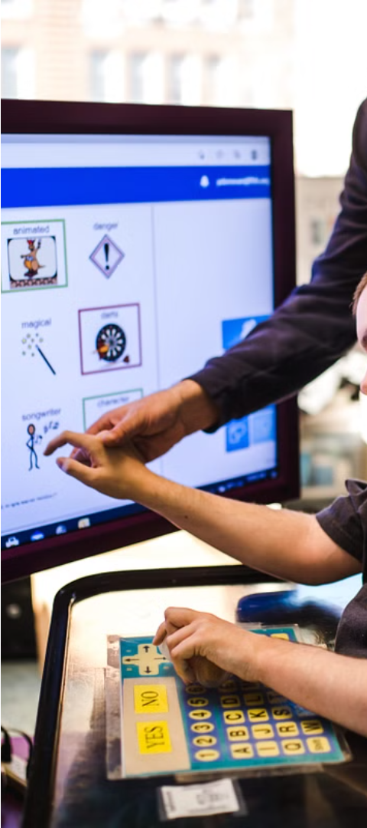
Empowering Through Technology
1
Engaging Animation Videos
LifeSkillLuminate will feature a library of captivating animation videos covering a range of essential life skills, including grocery shopping, cooking, managing finances, using public transportation, and personal hygiene.
2
Interactive Quizzes
Following each animation video, users will have the opportunity to engage in interactive quizzes that simulate real-life scenarios related to the skills they have just learned.

Slide 4

Objectives and Approach
Skill Development
Promoting Independence
Fostering Inclusion
We seek to facilitate the acquisition of practical life skills such as grocery shopping, cooking, managing finances, and using public transportation through engaging animation videos and interactive quizzes.
Our ultimate goal is to promote independence and autonomy among autistic individuals, enabling them to lead fulfilling and self-directed lives.
Through our project, we aim to promote greater inclusion and empowerment for individuals with autism within society.

Slide 5
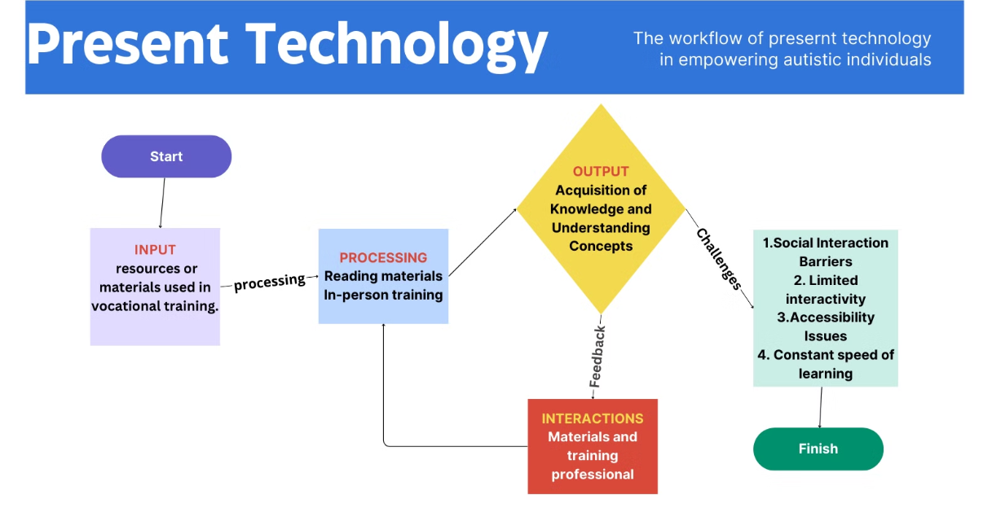
Existing Technology

Slide 6
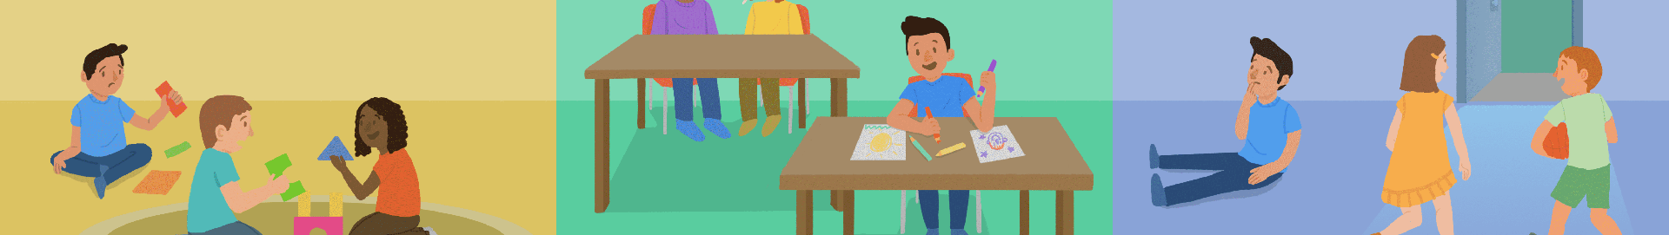
Limitations of Existing Approaches
1
Traditional Instruction Methods
2
Lack of Personalization
3
Insufficient Opportunities for Practice
Traditional teaching methods for life skills instruction for individuals with autism, such as one-on-one instruction, group sessions, and written materials, may not always be accessible or engaging due to their unique learning styles and sensory sensitivities.
Existing resources and interventions often lack personalization and customization for individuals with autism, resulting in limited engagement and effectiveness in skill acquisition due to unaligned learning styles and abilities.
Existing resources and interventions often lack personalization for individuals with autism, leading to limited engagement and effectiveness in skill acquisition due to unaligned learning styles and abilities.

Slide 7
Addressing the Gaps
Interactive and Engaging Learning
Expanded Content
Offering a diverse range of modules covering different aspects of printing and binding, as well as other vocational skills, to cater to various interests and career paths.
LifeSkillLuminate offers an interactive, engaging learning experience using animation videos and immersive simulations to enhance the acquisition of essential life skills for individuals with autism.
Opportunities for Practice
Promoting Independence and Inclusion
LifeSkillLuminate aims to empower individuals with autism through interactive quizzes and simulations, promoting the generalization and retention of essential life skills for confident real-world navigation.
LifeSkillLuminate empowers autistic individuals with life skills, fostering confidence, competence, and autonomy, promoting inclusion, integration, and a supportive environment, breaking down barriers.

Slide 8
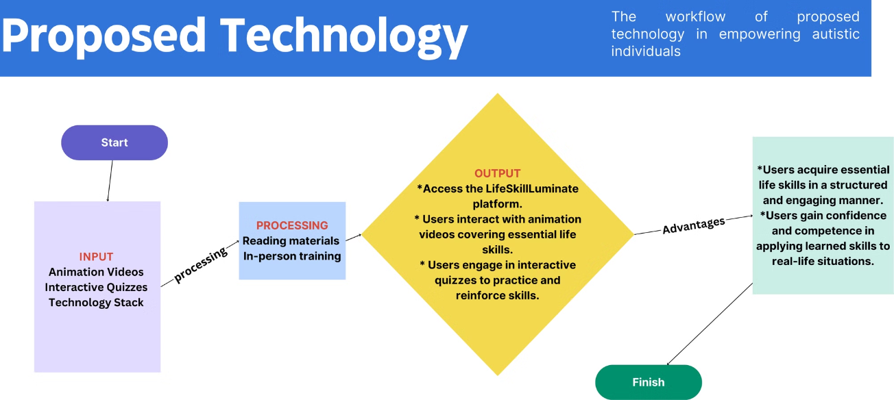
Proposed Technology

Slide 9






Expanding Horizons
Life Skills Modules
Community Engagement
Responsive Design
Explore a growing library of interactive modules covering a wide range of essential life skills, from personal care and household management to financial literacy and social interaction.
Connect with a supportive network of individuals with autism, caregivers, and professionals through forums, support groups, and peer mentoring programs.
The platform will utilize responsive design principles to ensure a seamless and consistent user experience across different screen sizes and devices.
Personalization
Comprehensive 3D Integration
Multi-language Support
Tailored learning experiences that cater to the unique needs and preferences of each individual. So that every individual will have special care and guidance
Converting every aspect of learning into 3D to provide a fully immersive and engaging educational experience.
Offering content in multiple languages to reach a broader, global audience.

Slide 10
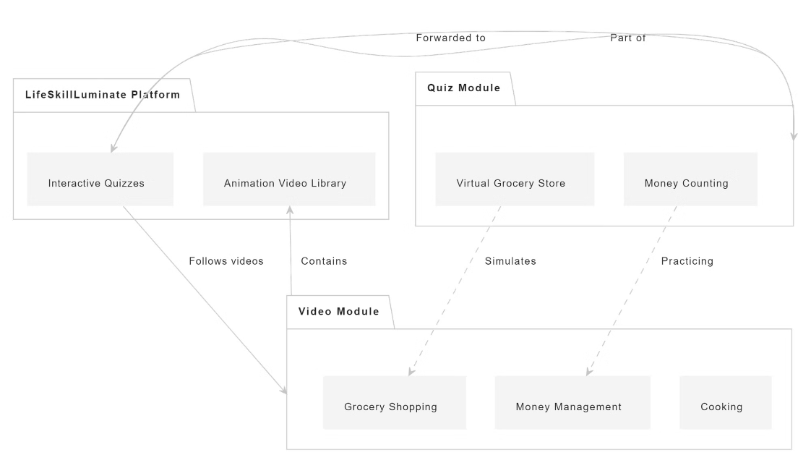
System Flow

Slide 11
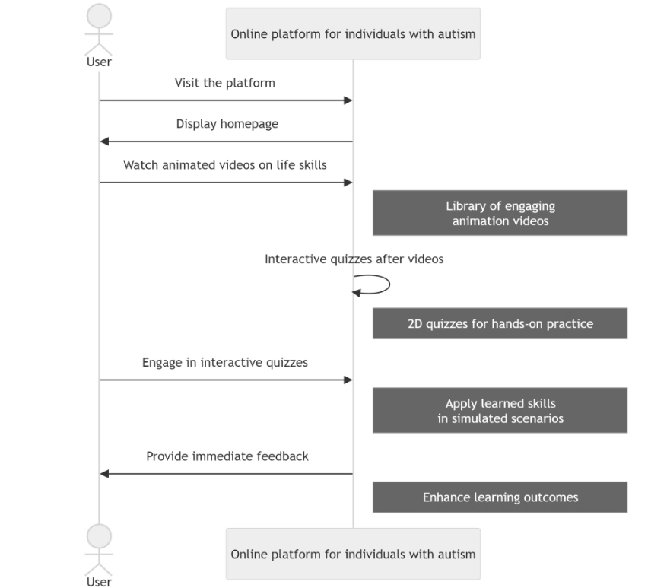
Sequence Diagram

